Slide 1

Medcurity Network Inventory
Team
< Brandon Huyck >
< Colleen Lemak >
< Artis Nateephaisan >
< Jack Nealon >

Slide 2
Project Overview
Project Purpose:
Facilitate risk assessment for medical offices (keep patient data secure)
Software and device inventory is first step
Required by HIPAA
Goal is to generate through automation
Tasks for Tool:
Scan the network
Store the data
Display to user, and allow updates
Export to Excel for accessibility
Notes:
[Brandon]
Goal: sponsor provides risk assessment for medical offices to help keep patient data secure; inventory is helpful in assessment and required by HIPAA; we develop a tool to automate the generation of this inventory.
Tasks: Scan the network; store the data; display to user and allow updates; export to excel for ease of accessibility (important to sponsor)

Slide 3
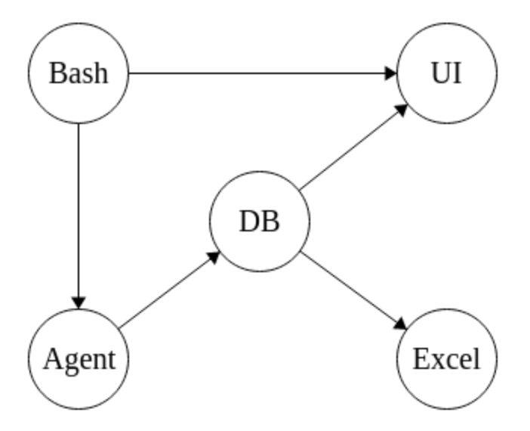
Project Block Diagram
Notes:
[Brandon] “Major Components”: Launch with bash, scan network, store info in db, display on ui, updatable through ui, export to excel with python

Slide 4
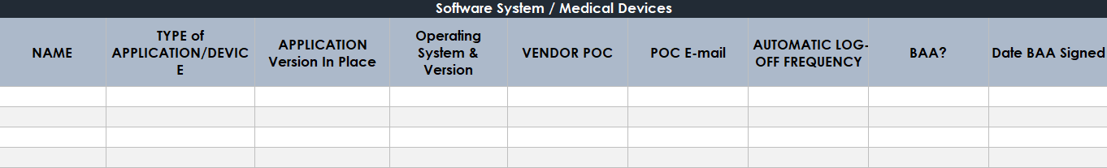
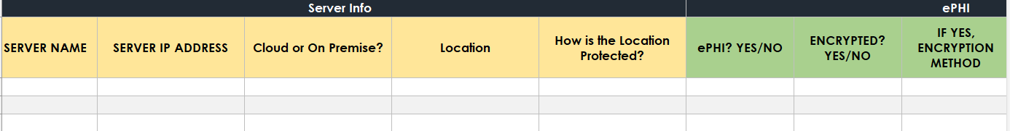
Excel Inventory Example
Notes:
[Brandon] “Major Components”: Launch with bash, scan network, store info in db, display on ui, updatable through ui, export to excel with python

Slide 5
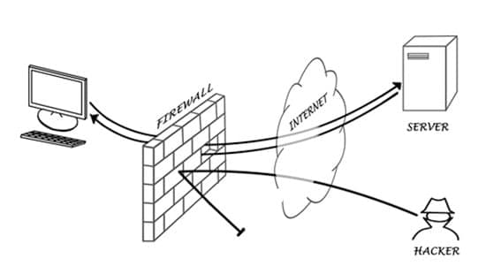
Considerations for the Crawl…
Requires authorization
Isolated ethical hacking
Computers are wired to defend information!

Slide 6
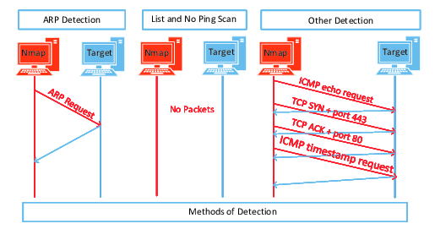
Our Test Network:
Python 3 script
Nmap
ARP Scanning
Raspberry Pi
Router

Slide 7
Successfully Crawled Attributes:
Gateway IP, Location, Subnet, Port Data’s Encryption Method
Device IP, MAC, type, OS name & version
Ports, status, service & version

Slide 8
Additional Work Accomplished
Database
Client, User, Vender, Server tables
Primary/foreign keys
Efficient execution
Python API for DB
User-Interface:
Initial UI with navigation
Login, Home, Settings pages
Notes:
If you can, show a live demo of the project working here or at the later slide on it - it'll depend upon how you want to move through the presentation
Discuss any progress made here
New pieces working, major changes needed
What have learned about the components/tools?

Slide 9
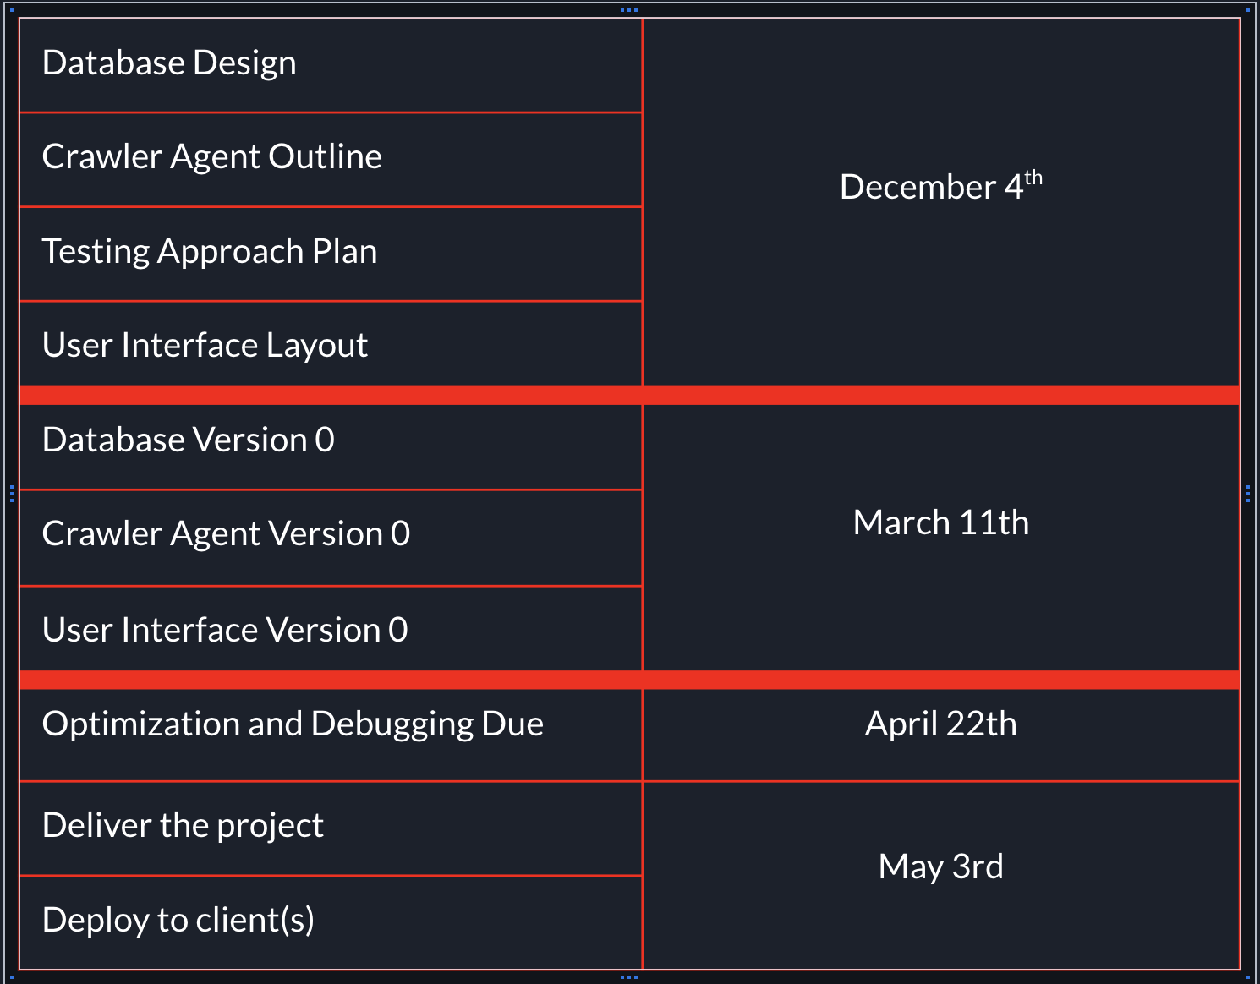
Comparative Timeline
Progressing well
DB Design, Crawler Outline, UI Initial Layout completed within first couple of weeks
DB, Crawler, UI v0 nearly complete
Finalize components, then pursue optimization, debugging, testing, documentation, etc

Slide 10
Project Management and Team Collaboration
Two weekly meetings: one with advisor, DAB member, sponsors as needed, and one with just the development team
Scrum leader goes over GitHub backlog, each member provides updates on progress, and work is assigned for next sprint
Mainly coded separately, questions and issues brought up in meetings
Communicated primarily through texts, email, and Discord
Notes:
What approaches has your team agreed to use for running the project
Two weekly meetings: one with advisor, DAB member, sponsors as needed, one with just the development team
Pull requests are created and we typically assign one other team member to review and approve the request and merge
Every sprint (2 weeks) we have a different team member lead the meeting and go through our backlog to get progress updates and assign backlog tasks as needed
Let us know how your team will be collaborating to make this happen
Communicated through texts and Discord messages
Mainly coded separately but brought up issues and during meetings and got them promptly resolved

Slide 11
Budget Plan and Status
Does your project plan require budget resources?
Cloud Service System (AWS)
Medcurity covers all AWS charges
Raspberry Pi and Router
Have not incurred any expenses, and do not foresee any expenses in the future
Notes:
Does your project plan require budget resources?
The main component that would require a budget was a cloud service system
Our sponsor had access to AWS, so we were set up the database needed for our project through that service
We were able to ask IT for a Raspberry Pi and we were able to gain access to a router used for testing our crawler
We have not used any budget and currently have no plans in doing so down the line

Slide 12


Updates to Project Risks and Delivery Issues
Risks:
Delivery:
Data Security Breach
Software Protocol Incompatibility
Database performance (update)
Tool: .exe
Output: Excel
Notes:
Protect credentials
Test various methods to communicate with device
Number of devices not anticipated to lower performance
Have you learned enough about your dependencies and other risks?
Alpha dev should give you knowledge if things will work or not
What is the current plan for packaging and delivery?
This includes testing, release, formats, and any live production systems you will have

Slide 13
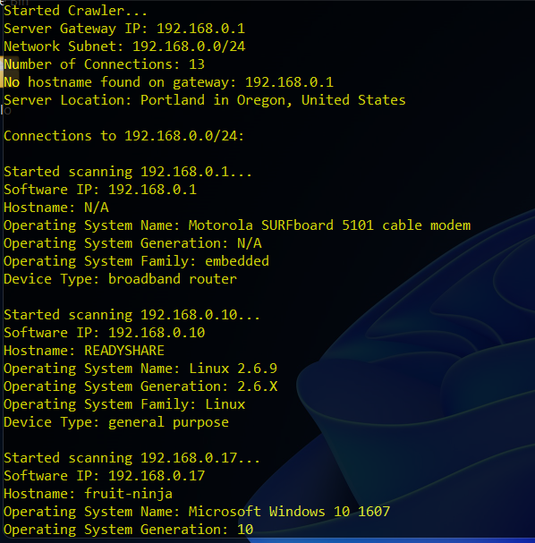
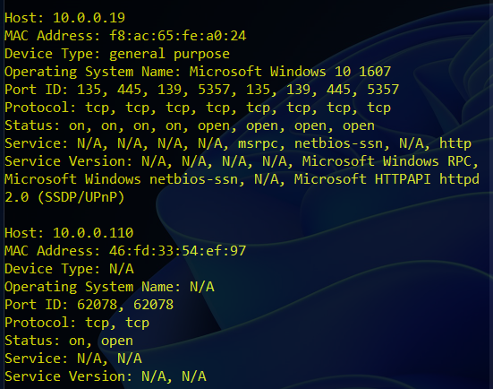
Crawler Agent Demo
Notes:
If there’s anything to show, do it here
This can include existing pages/tools that you’re expanding upon
It could include your UI sketches and descriptions of your project
It could also show off some of the libraries that you’ll be working with
As an alpha, there's multiple ways to approach the demo
At the very least show the parts that you do have working
This can be pulling data, a running database, a web interface that's partially finished
We know it's still early, but you should have something by now…

Slide 14
UI Demo

Slide 15
10/24-11/6 | 1/30 - 2/12
11/7 - 11/ 20 | 2/13 - 2/26
11/27 - 12/4 - Post Thanksgiving | 2/27 - 3/10 - Version 0 Complete
12/5 - 12/18 - Layouts + Outlines Done | 3/18 - 3/25 - Post Spring Break
12/19 - 1/1 - Winter Break | 3/26 - 4/8
1/2 - 1/15 - Winter Break | 4/9 - 4/22 - Debug and Optimize Done
1/16 - 1/29 | 4/23 - 5/3 - Delivery and Deployment
Revised Project Release Plan

Slide 16



Summary
Lots of progress:
Development flow:
Looking forward:
Scanning collects an array of information
Database is set up, with the Python API complete
UI has multiple pages built (Login, Home, etc.)
Teamwork, meetings, development strategies, etc.
Clear picture of the future work
Accomplishable in timeframe
Notes:
[Brandon]
This is a short presentation (target is 15 minutes + 5-8 mins in questions)
Focus on what business objectives you’re now able to confidently address and what notable wins you’ve had through your alpha dev window since the project plan presentation
In summary, we’ve made lots of progress in initial development of each component of the project
Scanning collects an array of information
DB is set up; python api is set up
UI login page built, home page built, and more
We’ve gotten into a flow with teamwork, team meetings, development strategies, etc.
Most importantly, we have a clear picture of the work that needs to be accomplished in the second semester, and believe in our ability to do so

